Slide 1
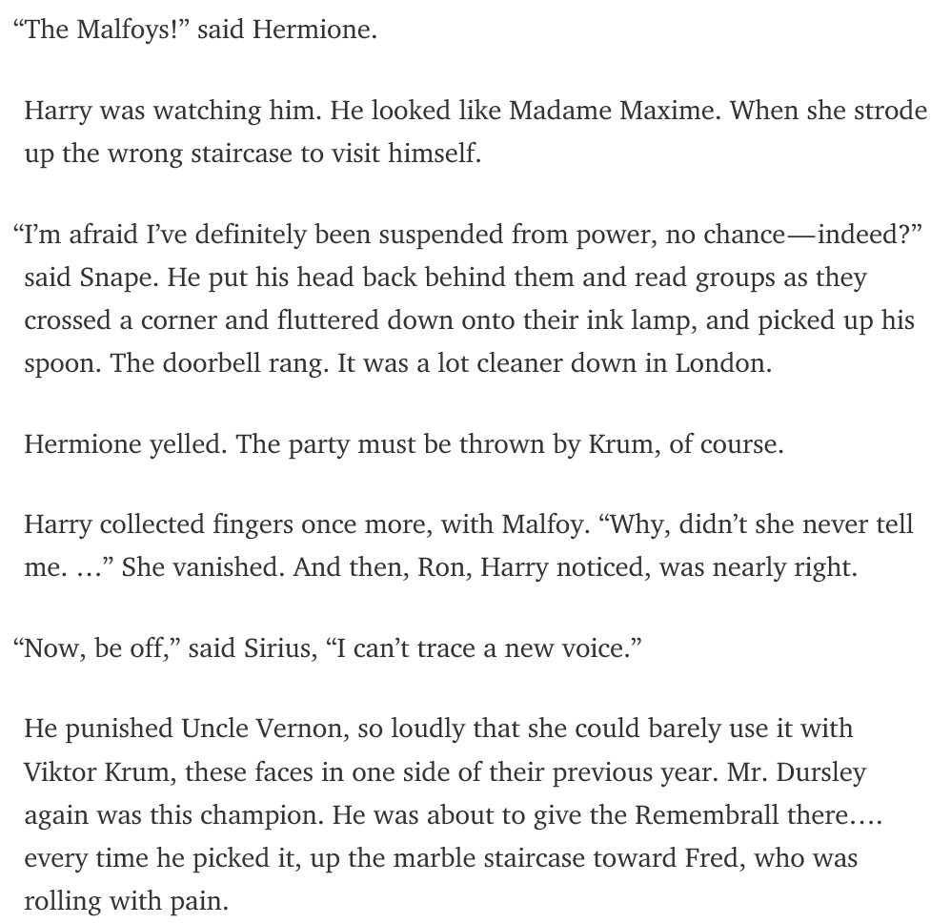
Notes:
Deutsch, M. https://medium.com/deep-writing/harry-potter-written-by-artificial-intelligence-8a9431803da6#.8mydijk4y

Slide 2

Track 2: Text Analytics
Wei Ann Lim, Data Scientist
APJ Innovation Center, Hewlett Packard Enterprise, Singapore
March 13, 2017
Notes:
http://supercomputingfrontiers.com/2017/
Email: Wei-ann.lim@hpe.com / wei-ann.lim@outlook.com

Slide 3
Notebook of the presentation is available from github:

Slide 4
Content
Introduction
Use Cases
Text Analytics demonstration – Parseltongue 101
Discussion, Q&A

Slide 5
Text analytics is the process of deriving information from text sources.
Gartner
Why? Because 80% of the data are unstructured data.

Slide 6

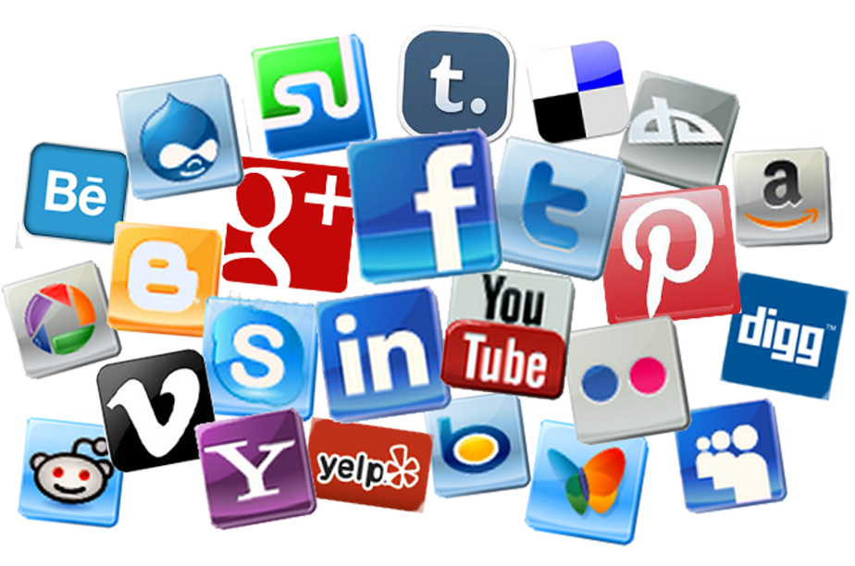











Slide 7
Use Cases
Hear the voices of customers
What are customers talking about you, about your competitors.
Focus your effort on the right things.
Lenovo used text analytics to measure customer’s experiences.
Targeted Marketing
Right place, right time and to the right person.
A text analytics company found that majority of the Father’s Day tweets were from women rather than men. The tweets are often about how to spend time with or what gifts to purchase for their father.
Fraud detection
In the insurance industry, text in the claim notes is a data source.
The condition suffered and the treatment undergone by the claimant can be extracted from the notes. These 2 information can be referenced back with the medical history of the claimant to check for inconsistencies or signs of fraud.

Slide 8
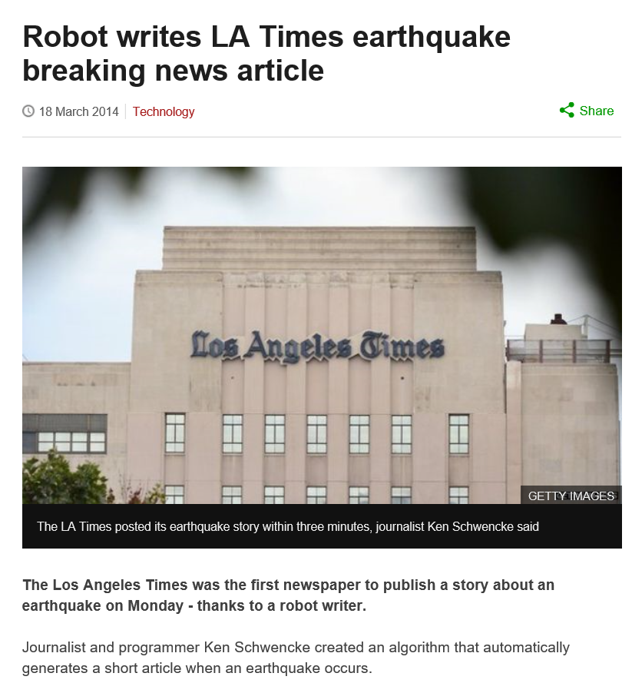
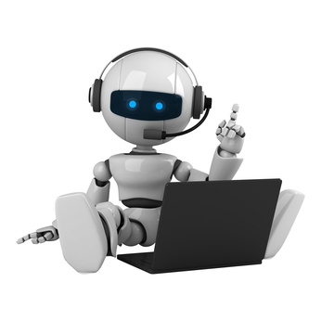
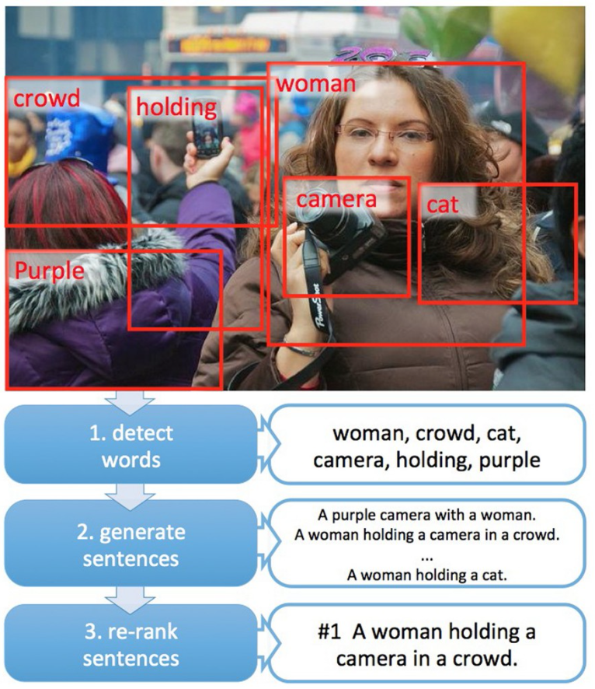
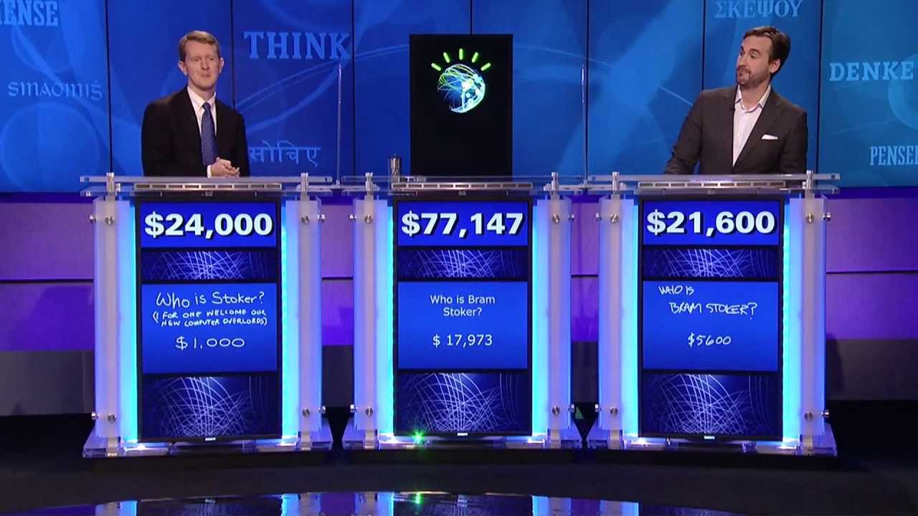

Slide 9
Demonstration

Slide 10
Lesson Summary
Notes:
We have taken a look at what text analytics is, and what are the applications. We have even seen a piece of text written using deep learning. The algorithm is able to derive some kind of structure from the text and output seemingly logical sentences.
Then we looked at some basic text analytics operations. We tokenized the sentences, remove punctuations and stop words, stem and lemmatize the token. After that, we counted the frequency of each word, and parsed it into a structured matrix. We converted the matrix into a sparse matrix to save memory.
Tokens can be enhanced by introducing part of speech, ngrams, entity recognition, and sentiment.
And all these are just for cleaning the text!
finally, to analyse the text, I introduced the cosine similarity and topic modelling.
So you see, the shortcomings of current state of the art is that it does not take into account the semantics of the words. You could well apply the same techniques to texts written by a monkey, and the techniques will still work. But the result will totally make no sense. I believe that the basis of text analytics should be learnt like how we learnt languages. Only when the computer has been taught some basics, can it learn to surf the web on its own, to learn more.
I shall stop being philosophical here, and hand over to… . Thank you for listening.

Slide 11
Summary
What text analytics is, and its applications.
Basic text analytics operations.
Lowercasing, removing stop words, removing punctuations, stemming and lemmatization.
Sparse matrix and tf-idf term weighting
Enhanced Tokens
Ngrams
POS
Entity recognition
Text analysis
Sentiment Analysis
Document Similarity (Cosine Similarity)
topic modelling.

Slide 12
Summary
Other topics not covered
Document classification.
Document summarization.
Notes:
You could well apply the same techniques to texts written by a monkey, and the techniques will still work. But the result will totally make no sense. I believe that the basis of text analytics should be learnt like how we learnt languages. Only when the computer has been taught some basics, can it learn to surf the web on its own, to learn more.

Slide 13
Source: Deutsch, M. https://medium.com/deep-writing/harry-potter-written-by-artificial-intelligence-8a9431803da6#.8mydijk4y
Notes:
The “abstract” from the Harry Porter book is written by a deep learning model.
Source: Deutsch, M. https://medium.com/deep-writing/harry-potter-written-by-artificial-intelligence-8a9431803da6#.8mydijk4y

Slide 14
Q&A

Slide 15
Reference
http://healthitanalytics.com/features/what-is-the-role-of-natural-language-processing-in-healthcare
Reference for the slide “Use Case in HealthCare
http://www.tcs.com/SiteCollectionDocuments/White%20Papers/Insurance_Whitepaper_Mining_Unstructured_Text_Data_for_Insurance_Analytics_08_2010.pdf
Reference for text analytics in the insurances industry.
http://www.scientificcomputing.com/blog/2014/01/text-mining-next-data-frontier
http://searchbusinessanalytics.techtarget.com/feature/Text-analysis-software-helps-Lenovo-zero-in-on-the-customer
http://karpathy.github.io/2015/05/21/rnn-effectiveness/
https://medium.com/deep-writing/harry-potter-written-by-artificial-intelligence-8a9431803da6#.8mydijk4y
Deutsch, M. https://medium.com/deep-writing/harry-potter-written-by-artificial-intelligence-8a9431803da6#.8mydijk4y

